Slide 1
Chapter 7
Learning Objectives:
Domain 3: Security Architecture and Engineering
3.9 Apply cryptography
3.9.1 Cryptographic lifecycle (e.g., key management, algorithm selection)
3.9.2 Cryptographic methods
3.9.3 Public Key Infrastructure
3.9.4 Key management practices
3.9.5 Digital signatures
3.9.6 Nonrepudiation
3.9.7 Integrity
3.9.8 Understand methods of cryptanalytic attacks
3.9.9 Digital Rights Management (DRM)

Slide 2
Asymmetric Cryptography
Based on pubic and private keys; key pairs to facilitate secure communications without complicated key distribution system

Slide 3
Public and Private Keys
Public keys are freely available to anyone with whom the want to communicate
Possession of public keys does not introduce weaknesses into the cryptosystem
The private key in reserved for sole use of the individual who owns the key
Sender encrypts with the recipient’s public key
Recipient decrypts with their private key

Slide 4
RSA
Ronald Rivest, Adi Shamir, Leonard Adleman
Developed the RSA algorithm in 1997; world-wide standard
Depends on computational difficultly inherent in factoring large prime numbers
See steps on page 240
Merkle-Hellman Knapsack
Similar to RSA, but relies on super-increasing sets rather than large prime numbers
Broken in 1984

Slide 5
El Gamal
1985, Dr. Tahir T. El Gamal published an article describing how mathematical principles behind the Diffie-Hellman key exchange can support public key cryptosystems for encryption and decryption
This became the foundation for SSL/TLS
Major advantage: Released to the public
Disadvantage: the algorithm doubles the length of the message it encrypts

Slide 6
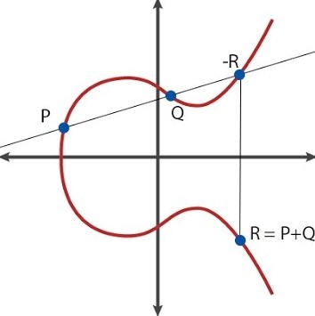
Elliptic Curve
Developed in 1985
Used mathematical computation to determine points on an elliptic curve
Computational difficult to determine x if the other values are known

Slide 7
Hash Functions
For comparison purposes only
Cryptographic function that generates a hash, digest, or message digest (it’s all the same thing.)
Both sender and receive use the same hash function
Sender generates a digest by providing input into the algorithm
The sender captures the hash value and sends it to the receiver
The receiver runs the input through the hash and compares the output to the one the sender sent
Can also be used as a digital signature

Slide 8
Hash Functions
Five basic requirements for a cryptographic function:
The input can be of any length
The output has a fixed length
The hash function is relatively easy to compute for any input
The hash function of one-way
The hash function is collision free
Two different input that produce the same digest is a collision
Common hash functions
SHA
MD
HMAC

Slide 9
SHA
Secure Hash Algorithm
SHA-1
Input of virtually any length; produces 160-bit message
SHA-2
Four variations; 224, 256, 384, and 512
SHA-3
Based on the Keccak algorithm
Different from previous function
Sponge function

Slide 10
MD
Message Digest
Developed by Ron Rivest in 1989
MD2
Supports 8-bit processors
Pads the message in multiples of 16 bytes
Cryptanalytic attacks exist against MD2
MD4
Supports 32-bit processors
Collisions make it no longer secure
MD5
Similar to previous versions
Implements additional security features that significantly reduces the speed of message digest production
Study Table 7.1 on page 246

Slide 11
Digital Signatures
Enforce nonrepudiation
Assures the recipient that the message was not altered in transit between sender and receiver
Rely on public key cryptography and hashing functions
See page 247 for digital signature process
Does not provide privacy; only ensures integrity, authentication, and nonrepudiation

Slide 12
HMAC
Hashed Message Authentication Code
Implements a partial digital signature
Guarantees integrity, but does not provide for nonrepudiation
HMAC can be combined with an standard message digest generation algorithm by using a shared secret key
Only the two parties have the key
Input + key = digest
In between unencrypted use of a message digest and computationally expensive digital signature in PKI

Slide 13
Digital Signature Standard
NIST specifies the digital signature algorithms acceptable for federal government use in FIPS 186-4, aka Digital Signature Standard (DSS)
All federally approved digital signature algorithms must use SHA-3
Encryption algorithms include:
DSA
RSA
ECDSA

Slide 14
Public Key Infrastructure
Facilitates communications between previously unknown parties
PKI provides a hierarchy of trust which permits combining asymmetric cryptography with symmetric cryptography along with hashing and digital signatures, aka hybrid cryptography

Slide 15
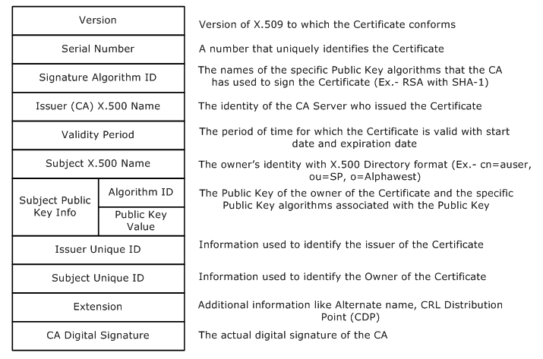
Certificates
Digital certificates provide communicating parties with assurance that they are communicating with trusted parties
Digital certificate are endorsed copies of an individual’s public key
Based on the X.509 certificate format

Slide 16
Certificate Authorities
CA
Neutral organizations that offer notarization services for digital certificates
Verifies identity of the applicant
Trust is important for CAs
Registration Authorities (RA)
Assist the burden of verifying users’ identities prior to issuing digital certificates

Slide 17
Certificate Generation and Destruction
Enrollment
First prove identity to the CA
Provide the public key
CA binds user identity and public key and then digitally signs it with the CA’s private key

Slide 18
Certificate Generation and Destruction
Verification
When you receive a digital certificate from someone, verify the certificate by checking the CA’s digital signature using the CA’s public key
CRL
OCSP
If only the email is used in the certificate as identification, then the authenticity of the sender is in doubt
Significant security issues:
Symantec
GoDaddy

Slide 19
Certificate Generation and Destruction
Revocation
Reasons to revoke a certificate:
The certificate was compromised
The certificate was erroneously issued
Details about the certificate changed
The security association changed
Certificate Revocation List
Maintained by the various CAs and contain the serial numbers of issued and revoked certificates
Must be downloaded and cross-referenced periodically
Online Certificate Status Protocol
Eliminates the latency of CRLs
Real-time request/response

Slide 20
Asymmetric Key Management
Choose an encryption system with an algorithm in the public domain that has been thoroughly vetted by industry experts
Select your keys in an appropriate manner
When using public key encryption, keep the private key secret
Retire keys when they have served a useful life
Back up your keys!
Hardware Security Module (HSM)
Provides an effective way to mange encryption keys
Store and mange encryption keys in a secure manner that prevents humans from ever needing to work directly with the keys.
Trusted Platform Module (TPM)
Chip on a motherboard that provides key storage and implementation for FDE

Slide 21
Applied Cryptography
Portable devices
Laptops, notebooks, smartphones, tablets, etc.
Could cause serious harm to an organization if it contains sensitive information and is lost or stolen

Slide 22
Applied Cryptography
Email
Security should be cost effective
Need confidentiality? Encrypt the message
Need integrity? Hash the message
Need authentication, integrity, and/or nonrepudiation? Digitally sign it
Require confidentiality, integrity, authentication, and nonrepudiation? Encrypt and digitally sign it
It is always the responsibility of the sender to put proper mechanisms in place to ensure security of a message or transmission
Pretty Good Privacy
S/MIME

Slide 23
Applied Cryptography
Web applications
Encryption is widely used to protect web transactions
SSL
Developed by Netscape for client/server encryption for web traffic
HTTPS (port 443)
Relies on exchange of digital certificates to negotiate encryption/decryption parameters between web browser and web server
TLS
Replacement for SSL
HTTPS (Port 443)
Incorporates security enhancements
TLS v1.2 and TLS v1.3 does not support downgrading

Slide 24
Steganography and Watermarking
Steganography
Makes alterations to a file using the least significant bit in an image file
Change are so minor, that it is imperceptible to the human eye
Can be used by anyone
Watermarks are a legitimate use for steganography

Slide 25
Digital Rights Management
Software uses encryption to enforce copyright restrictions on digital media
Can be applied to a variety of media types; especially music
Not without controversy
Music DRM
Movie DRM
E-book DRM
Video Game DRM
Document DRM

Slide 26
Networking
Secure networking services
Providing a method to transfer data

Slide 27
Networking
Circuit Encryption
Link Encryption
Protects the entire communications circuit by creating a secure tunnel between two points using either hardware or software solutions
End-to-end encryption
Protects communications between two parties and independent of link encryption
SSL/TLS
Critical difference
In link encryption, all the data including the header, trailer, address, and routing data is also encrypted
End-to-end encryption does not encrypt the header, trailer, address, and routing data
OSI model
In higher layers, it’s usually end-to-end encryption
In the lower layers, it’s usually link encryption

Slide 28
Networking
IPsec
A standard architecture set forth by the IETF
Communication is usually between two systems, two routers, two gateways, or any combination
It is an open, modular framework that is cross-platform compatible
Uses public key cryptography
Primarily used for VPNs
Commonly paired with L2TP
Transport or tunnel mode
Relies on Security Associations:
AH – provides assurance of message integrity, nonrepudiation, authentication, access control, and prevents replay attacks
ESP – provides confidentiality, integrity, encryption, limited authentication, and prevents replay attacks

Slide 29
Networking
IPsec
Internet Security Association Key Management (ISAKMP) Protocol
Provides background security support for IPsec by negotiating, establishing, modifying, an deleting security association
Four basic requirements:
Authenticate communicating peers
Create and manage security associations
Provide key generation mechanisms
Protect against threats (replay and DoS attacks)

Slide 30
Networking
Wireless Networking poses tremendous security risks
Transmitting data through the air leaves them vulnerable to interception
WEP
WPS
WPA
WPA2
802.1x

Slide 31
Cryptographic Attacks
Analytic attack
Algebraic manipulation that attempts to reduce the complexity of the algorithm
Implementation attack
Exploits weaknesses in the implementation of the cryptography system
Focuses on the software code
Statistical attack
Exploits weaknesses in the cryptosystem; e.g. floating point errors and PRNG
Brute force attack
Attempt every possible combination for a key or password

Slide 32
Cryptographic Attacks
Frequency Analysis and the Ciphertext Only Attack
Known Plaintext – attacker has both ciphertext and plaintext
Chosen Ciphertext – attacker can decrypt chosen portion of ciphertext
Chosen Plaintext – attacker can encrypt chosen plaintext
Meet in the Middle – defeat encryption that uses two rounds
Man in the Middle – Intercepts all communications
Birthday – aka Collision attack or reverse hash matching
Replay – Intercepts an encrypted message and then later “replays” the message to open a new session

Slide 33
Summary
Asymmetric encryption, aka public key encryption
Digital signatures
Popular cryptographic algorithms
Email: PGP and S/MIME
Web: SSL/TLS
VPN: IPsec and ISAKMP
Wireless: WPA/WPA2

